Slide 1

CarFAQs
CSE111 Database Systems | Fall 2022
CarFAQs
Chester Merino
Tim Chan
Notes:
https://github.com/Lunarkikes/CSE-111-Project-Chester-Tim

Slide 2
Specifications
Allows user to search dealership database for:
Cars in inventory
Sold cars’ sales history
Cars undergoing/need repair
Maintenance records for customer’s cars
User can search cars or records by:
VIN Year Make Model Color Trim | Invoice number Service record number Date serviced Date sold Repair(s) needed or done

Slide 3
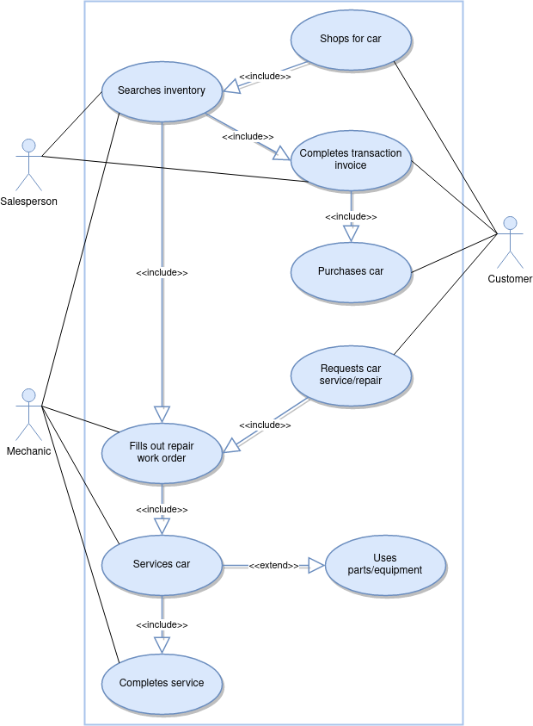
Use-case Diagram
Use-case Scenario 1: Customer purchases car
Customer wants specific type of car
Salesperson searches inventory matching specs
Customer and Salesperson complete paperwork
Customer purchases car
Use-case Scenario 2: Customer needs repairs done
Customer brings car in and requests service
Mechanic fills out repair work order
Mechanic(s) service car
Service requires use of parts or equipment (optional)
Mechanic completes service

Slide 4
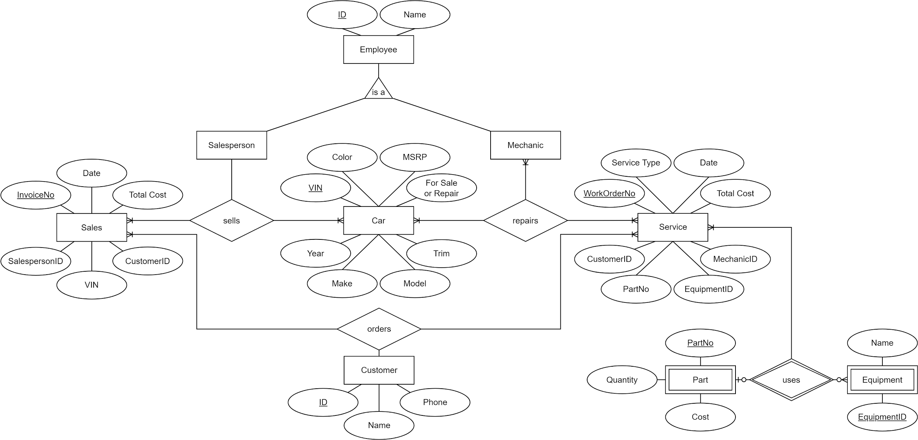
E/R Diagram

Slide 5
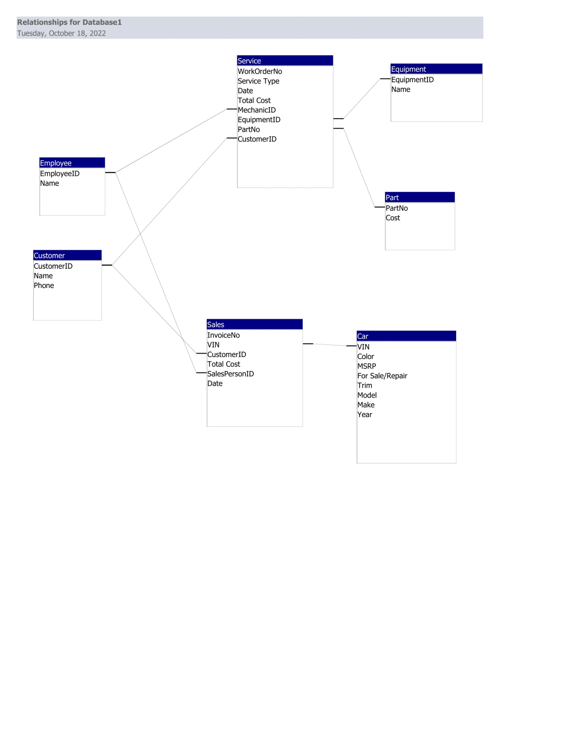
Relation Tables

Slide 6

Thanks!
Notes:
https://github.com/Lunarkikes/CSE-111-Project-Chester-Tim

